Slide 1
User Experience Study on DASH
Liu Yitong, Liu Hao, Shen Yun, Lin Qi, Shen Hui, Li Yuchen
liuyitong@bupt.edu.cn
Wireless Theories and Technologies Lab
Beijing University of Posts and Telecommunications

Slide 2
Summary
DASH QoE Evaluation
  Build BUPT QoE model of DASH service
  More accurate than UCSD model
  Research impacts of 3 impairment factors on DASH service: Initial Delay, Stall, and Level Variation
  Propose an accurate QoE model considering level variation
  Based on Primacy and Recency Effects
  Identify level variation influence factors: Bitrate Switching, Bitrate Fluctuation Pattern
DASH User Experience Improvement
  Study on QoE-based bitrate adaptation algorithm in DASH service
  Analyze stall probability and duration
  Utilize a real-time QoE model with stall prediction into the bitrate adaptation algorithm
  Select bitrate level to maximize QoE
  Propose a bandwidth estimating method in DASH service
  Consider 2 typical scenarios
  Response quickly for long-term variation and keep stable for short-term fluctuation
  Research on the performance of bitrate adaptation for multi-user DASH（On-going）

Slide 3



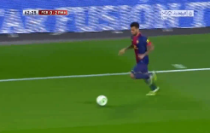
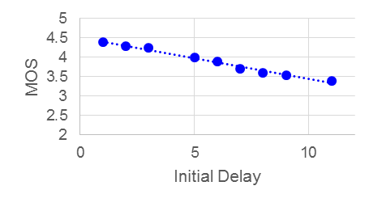
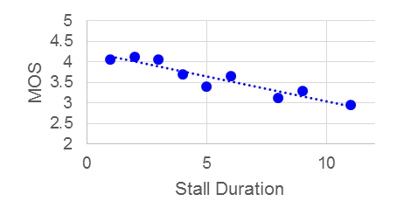
User Experience Impairment Factors on DASH Service
R = f(I_{ID}, I_{ST}, I_{LV})
Impairment due to Initial Delay
Impairment due to Level Variation
Impairment due to Stall
Medium motion
High motion
Video | Amount | Motion | Test factors
Bunny Cartoon | 11 | Medium | Stall
Movie Case | 48 | Medium | All factors*
Sport Case | 48 | High | All factors
    More than 2800 votes are received
    Test 107 video samples and 64 participants
Evaluation methodology: Single-Stimulus (SS)
All factors*: Stall, Initial Delay, and Level Variation
Conclusion
Impairments of Stall and Level Variation is more serious than Initial Delay.(1st row)
Initial Delay is nearly independent with Stall and Level Variation. (2nd and 3rd row)
Initial Delay and Stall Duration follow linear relation with QoE
Correlation of impairment factors
Variation | R | I_{ID} | I_{ST} | I_{LV}
R | —
I_{ID} | 0.234 | —
I_{ST} | 0.001 | 0.327 | —
I_{LV} | 0.000 | 0.927 | 0.946 | —
*Strong correlation when value <0.05
Guidance by Qualcomm Research: Yinian Mao (SD), Sha Hua (SD), and Ruiming Zheng (BJ)

Slide 4
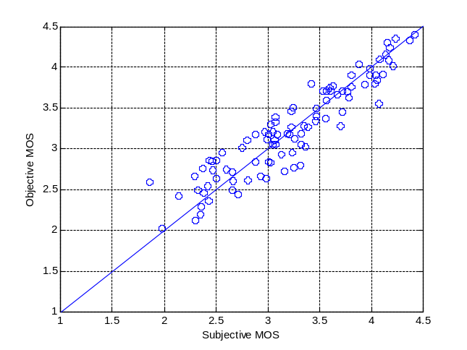
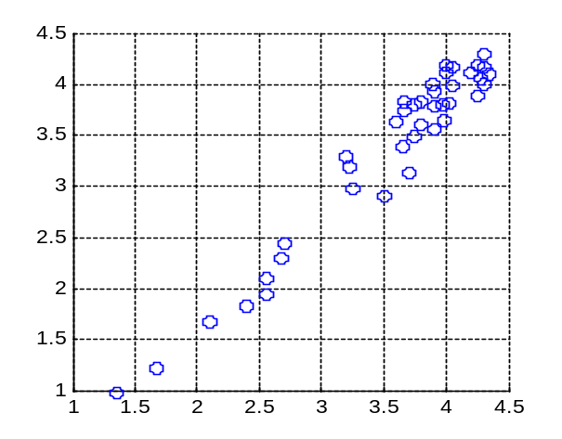
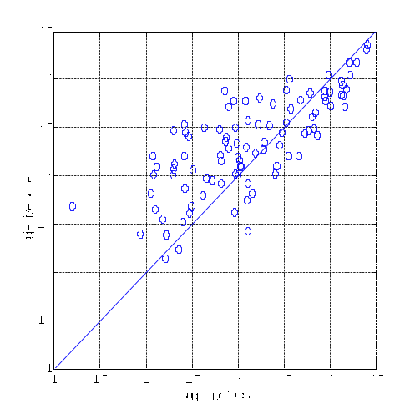
Propose QoE Model
Conduct subjective test on Qualcomm’s request
Validate the UCSD model with BUPT subjective results
UCSD model is not accurate in BUPT subjective test
Build a new model based on the observation of 3 impairment factors
UCSD Model
BUPT Model
  The best formulation out of 15 basic elementary functions
Performance analysis
Performance of BUPT Model
Performance Validation of UCSD Model
PCC : 0.9251 MSE : 0.0536
Performance is improved, even better in low motion scenario.
Result of UCSD Model
(Provided by UCSD)
PCC : 0.91
MSE : 0.082
Our Validation Result of UCSD Model
PCC : 0.7811
MSE : 0.1821

Slide 5
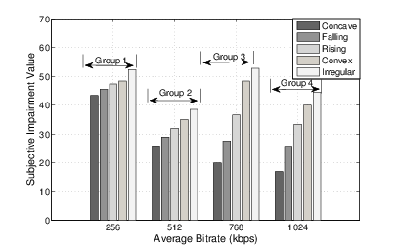
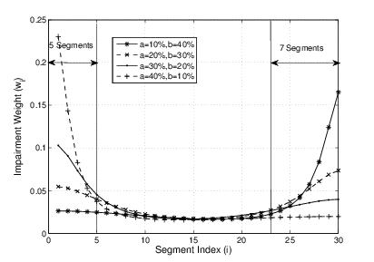
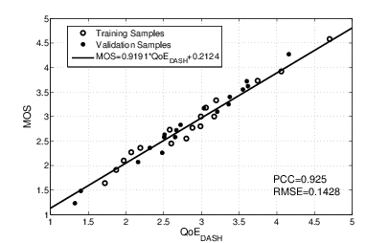
QoE Model for Level Variation
    Influence factors from the subjective test:
  Average bitrate
  Bitrate switching frequency
  Bitrate fluctuation patterns: Concave, Falling, Convex, Irregular
Impairment on bitrate fluctuation pattern I_{BFP}
  Based on Primacy and Recency Effects
  Evaluation functions of BFP in the posters
Impairment on bitrate switching I_{SW}
  Frequency downward bitrate switching causes serious subjective impairment
QoE evaluation functions:
Notes:
Irregular: bitrate switches frequently with huge amplitude
QoE dash属于1-5
35 test videos from both simulated environment and real network traces
PCC= 0.92, RMSE = 0.14

Slide 6

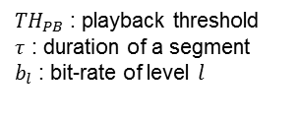
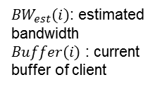
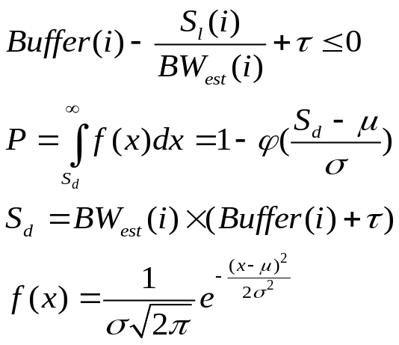
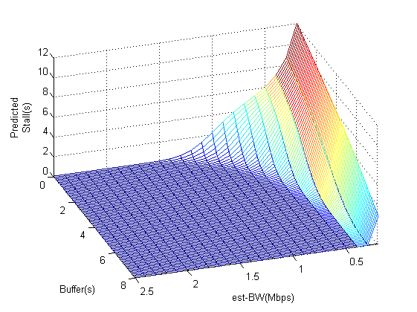
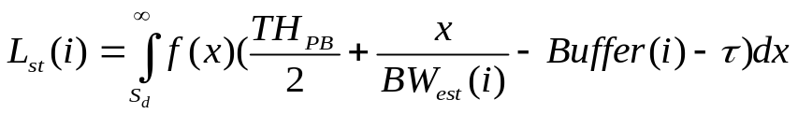

Stall Prediction of DASH Service
Segment size (bytes) obeys Gaussian Distribution ^{[1]}
Stall probability
Stall duration
Apply (5) into Ref.[2] to get the QoE impairment prediction of Stall
(1)
(2)
(3)
(4)
(5)
(6)
[1] Dmitri Jarnikov et al, "Client intelligence for adaptive streaming solutions “, 2011
[2] Yao Liu et al,” User Experience Modeling for DASH Video” ,2013

Slide 7
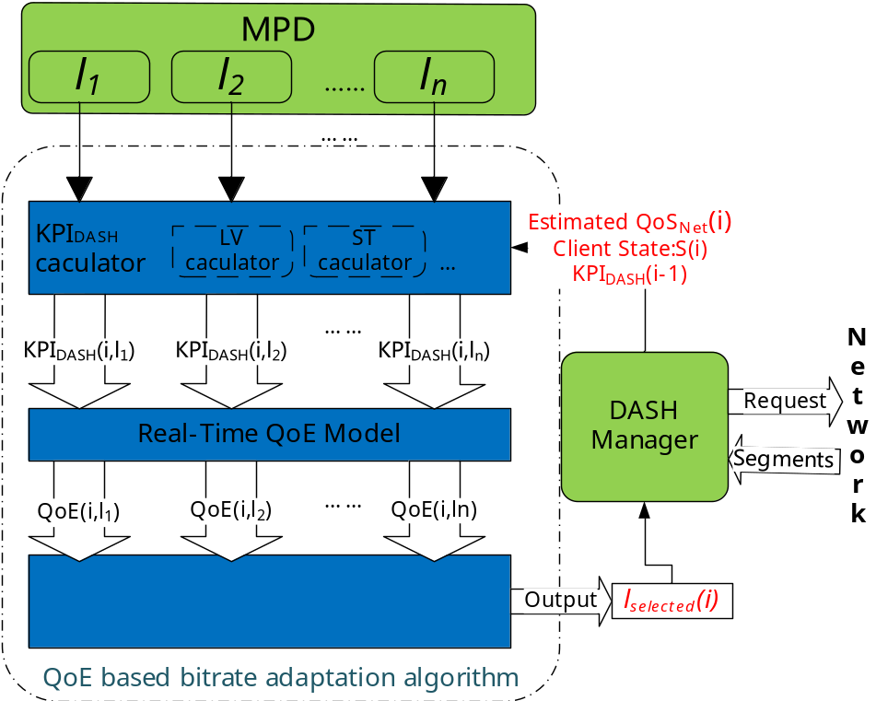
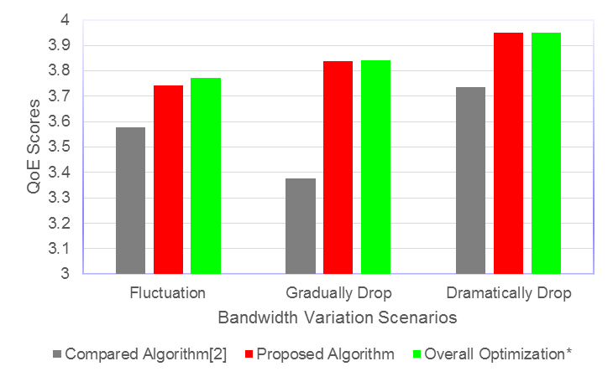
QoE Based Bitrate Adaptation in DASH
Performance simulation
*Modify QoE model^{[1]} into real-time form
*Overall Optimization^{[3]} : theoretical upper bound under a given bandwidth variation scenario.
Select bitrate level l_{selected}(i) for requesting segment i, according to:
QoS_{Net}(i) : network condition;
S(i): DASH client state(buffer length.etc);
KPI_{DASH}(i-1): previous KPIs of DASH( stall, initial delay, level variation etc.).
Orient to maximize use experience
[1] Yao Liu et al,” User Experience Modeling for DASH Video” ,2013.
[2] Dongeun Suh et al, "QoE-enhanced Adaptation Algorithm over DASH for Multimedia Streaming" 2014.
[3] Dmitri Jarnikov et al, "Client intelligence for adaptive streaming solutions “, 2011.

Slide 8
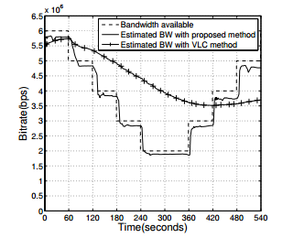
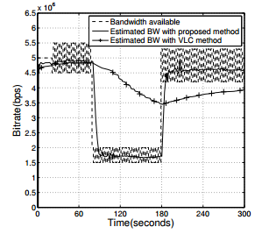
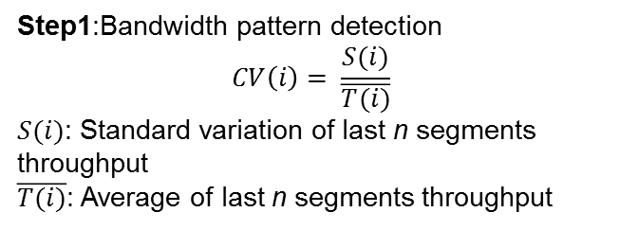
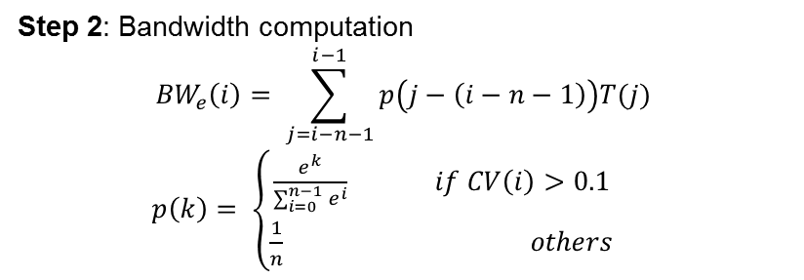
Bandwidth Estimation in DASH
2 typical scenarios
  Long-term variation within a wide range – Response quickly
  Short-term fluctuation within a narrow range – Keep stable

Slide 9
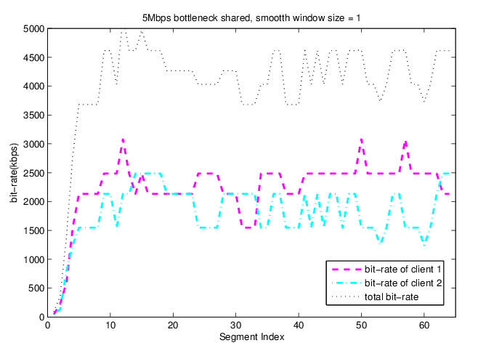
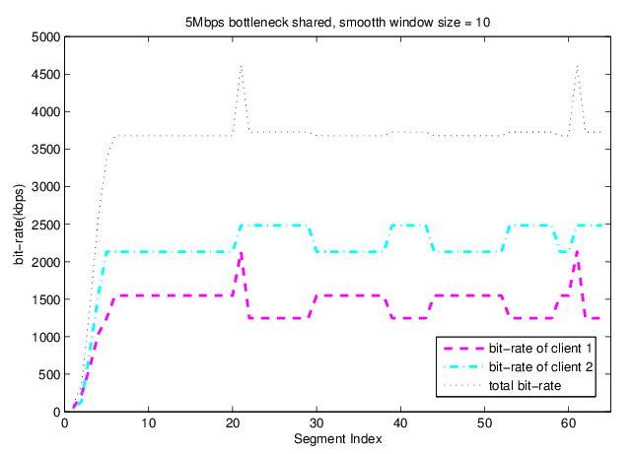
Multi-Users in DASH service (on going)
More practical scenario: multi-users in DASH service environment
Analyze different bitrate adaptation algorithms
  When bitrate adaptation is smoother, fairness and efficiency are less suffers.
Further work:
  Improve fairness and efficiency / Trade off between QoE and fairness
Users=2 , smooth window size = 1
Users=2 , smooth window size = 10
Unfairness = 545.9, Utilization = 0.819
Unfairness = 784.3, Utilization = 0.712
Smooth window size: The number of segments which is involved in bandwidth estimation.
9

Slide 10


